Slide 1


Kush Neal Bansal
01/09/2024

Slide 2

Outline
Executive Summary
Introduction
Methodology
Results
Conclusion
Appendix

Slide 3
Executive Summary
Using SpaceX data to determine cost of rockets
Using Data analysis and Machine Learning to analyze and predict success factors for SpaceX launches and First Stage recovery
Orbit, Launch Site, and Payload Mass are among the top variables that affect mission success and First Stage recovery
Machine Learning models can predict success at 83% accuracy

Slide 4
Introduction – So you want to go to space
The Set-Up
Space travel is very expensive ~$165M per launch
SpaceX – recover the first stage → brings down cost to $65M
Not 100% successful, but what if we could decrease the risk of failure?
The Problem
What data can we pull from previous SpaceX launches to increase the probability of success?
What factors can lead to failure? What algorithms can we use to predict success?

Slide 5

Section 1

Slide 6
Methodology
Executive Summary
Data collection methodology:
Describe how data was collected
Perform data wrangling
Describe how data was processed
Perform exploratory data analysis (EDA) using visualization and SQL
Perform interactive visual analytics using Folium and Plotly Dash
Perform predictive analysis using classification models
How to build, tune, evaluate classification models

Slide 7
Data Collection
SpaceX REST API Calls
Performed GET-Response requests to get various rocket data and flight outcomes
Built functions to translate IDs to names of locations, boosters, etc.
Normalized the data into a flat table and dealt with missing values
Filtered for Falcon 9 launches
Web Scraping
Performed GET response for Wikipedica page on Falcon 9 launches
Parsed text with BeautifulSoup to extract columns from table headers
Extracted data from table rows to build a Pandas DataFrame

Slide 8
Data Collection – SpaceX API
Data Received
Rocket Data
Booster Version
Payload
Mass, Orbit
Launchpad
Launch Site, Latitude, Longitude
Cores
Outcomes, type of landing, flights with core, number of reuses, gridfins, legs, landing pad
REST Clients
(computer, phone)
REST SERVER
(SpaceX data resources)
REST request
Send request URL to SpaceX API
GET method
API receives
request
Ex. launches/past
User receives json files, normalized to table
REST Response
JSON file
Returns JSON file

Slide 9
Data Collection - Scraping
Data Received
GET request to Wikipedia server
Place your flowchart of web scraping here
Launch Site
Payload
Payload Mass
Orbit
Customer
Launch Outcome
Version Booster
Booster Landing
Date and Time
Received HTML file, parsed with BeautifulSoup
Extracted table headers, table data to build DataFrame

Slide 10
Data Wrangling
Created landing outcome label to track which launches landed successfully → determined success rate of 67%
Landing Outcome | Meaning
True ASDS | Successful (drone ship)
False ASDS | Failure (drone ship)
True RTLS | Successful (ground pad)
False RTLS | Failure (ground pad)
True Ocean | Successful (ocean)
False Ocean | Failure (ocean)
None None | Failure to land
None ASDS | Failure to land
Launch Sites | Names
CCAFS SLC 40 | Cape Canaveral Space
KSC LC 39A | Kennedy Space Center
VAFB SLC 4E | Vandenberg Air Force Base

Slide 11
EDA with Data Visualization
Charts built primarily generated correlation between:
Launch Site, Flight Number, Payload Mass, Orbit
Additional charts show:
Success Rate over Time
Success Rate by Orbit
Correlation Charts
How do two variables relate
Generates visible trends
Success Rate Graphs
Visualize what has worked and what has not

Slide 12
EDA with SQL
SQL queries are more readable and understandable
Can provide data analysis and summaries
Query Summary
Unique Launch Sites
Cape Canaveral records
Payloads by NASA
Booster F9 v1.1 Payload
First successful ground pad landing
Boosters with drone ship success
Mission Outcome Statistics
Boosters that carried Max payloads
2015 Drone Ship landing failures
Ranked landing outcomes (6/4/2010 – 3/20/2017)

Slide 13
Build an Interactive Map with Folium
Folium allows users to visualize geospatial data
Folium Elements
Circles – provides a circle of where the coordinates are
Marker – provides a pin with name of location
MarkerCluster – provides number of markers in one area if they are close together

Slide 14
Build a Dashboard with Plotly Dash
Plotly Dash allows you to build shareable, interactive dashboards
Dropdown menu to select all launch sites and drill down to specific launch site
Pie Chart
All Landing Sites – provides success rate of each landing site from total successes
Filtered landing site – provides percent of success and failures at specific landing site
Payload Mass vs Launch Outcome Correlation
Provides booster versions that are interactable
Provides Payload slider to adjust Payload Mass
Filters to specific landing site when dashboard is changed

Slide 15
Predictive Analysis (Classification)
Classification Methods
Logistic Regression – similar to linear regression; used for discrete target field to create decision boundaries
Support Vector Machines – classifies by finding a separator
Decision Trees – map out possible decision paths and probabilities
K-Nearest Neighbor – classifies data points based on similarity to other data points
Refinement with hyperparameters
GridSearchCV – uses different combinations of hyperparameters to train and evaluate model
Evaluation
Accuracy Score – percent of labels that exactly match
Confusion Matrix – matrix that shows what the model guessed correctly and incorrectly
Train-Test-Split: Split the data into training and testing data
Training – Train each model on the training data
Test – Test how well the model predicts the values
Evaluate – use statistical scores to determine accuracy and compare models

Slide 16

Section 2

Slide 17
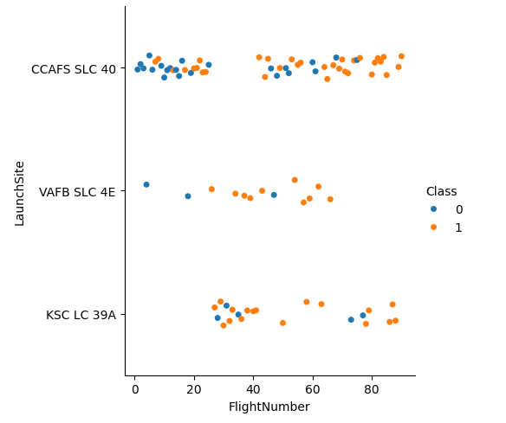
Flight Number vs. Launch Site
Correlates flight number and launch site
Class represents landing success (1) and landing failure (0)
Conclusions
Higher success rate the higher the flight number
Cape Canaveral is the most popular launch site

Slide 18
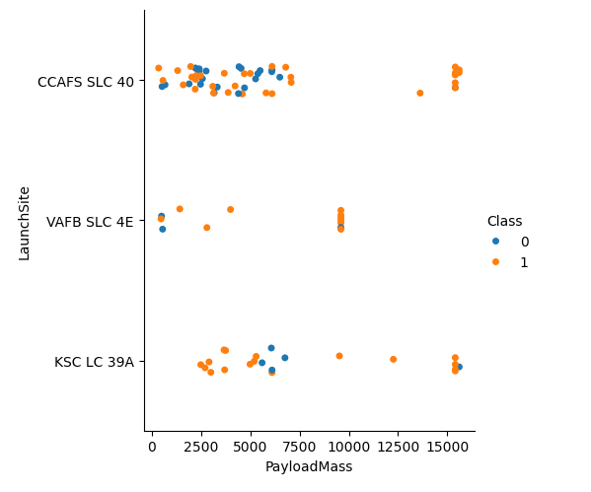
Payload vs. Launch Site
Correlates Payload Mass to Launch Site
Conclusions
Cape Canaveral launches with at least 12,500kg payloads tend to succeed
Vandenberg does not exceed 10,000kg payloads
Vandenberg launches with 10,000kg payloads tend to succeed

Slide 19
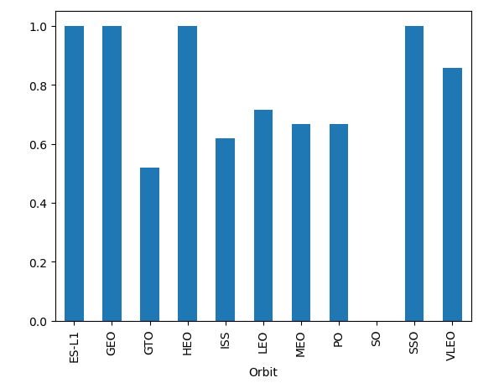
Success Rate vs. Orbit Type
Orbit | Explanation
ES-L1 | Lagrange Points
GEO | Geosynchronous Orbit
GTO | Geostationary Orbit
HEO | Highly Eliptical Orbit
ISS | Space Station
LEO | Low Earth Orbit
MEO | Medium Earth Orbit
PO | Polar Orbit
SO | Solar Orbit
SSO | Sun-synchronous Orbit
VLEO | Very Low Earth Orbit
Conclusions Average Success Rate by Orbit Type
ES-L1, GEO, HEO, and SSO are successful

Slide 20
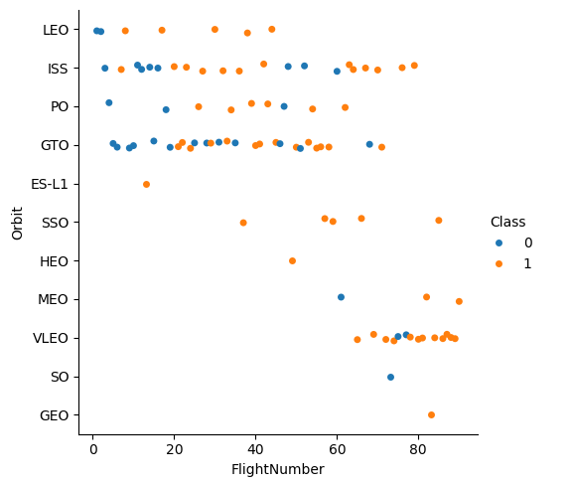
Flight Number vs. Orbit Type
Correlates flight number and orbit type
Conclusions
Fewer failures as flight number increases
VLEO are more popular

Slide 21
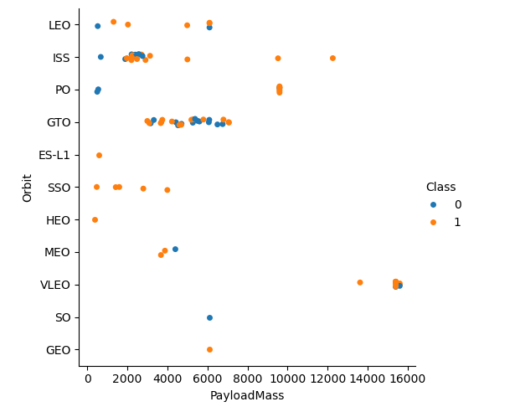
Payload vs. Orbit Type
Correlation between payload mass and orbit type
Conclusions
VLEO payloads are greater than 13,000kg
GTO payloads are between 3,000 and 8,000kg
SSO payloads are less than 6,000kg

Slide 22
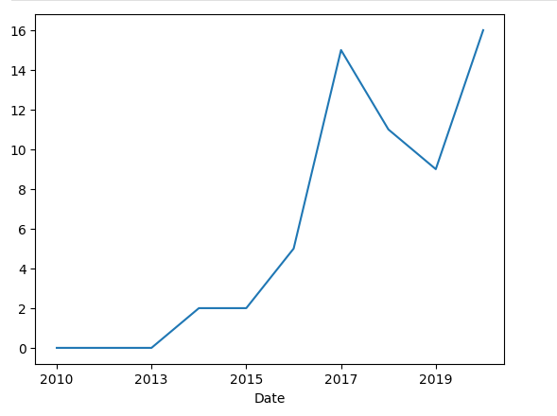
Launch Success Yearly Trend
Line chart of launch success over time
Conclusions
Exponentially growing success
Slight dip from 2017-2019 but could recover

Slide 23
Common SQL Terminology
Query – a line of code that does something to a table
%sql – a command that allows user to execute SQL queries in Python
SELECT – picks columns from the data table
FROM – data table you are pulling from (in this case, SPACEXTABLE)
WHERE – filters data table
GROUP BY – group like rows by a specific column
ORDER BY – orders final table by a specific column (DESC or ASC)

Slide 24
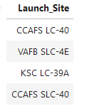
All Launch Site Names
Query
%sql SELECT DISTINCT Launch_Site
FROM SPACEXTABLE
Explanation:
Pulls names of launch sites from the SPACEXTABLE table
Distinct prevents any duplication

Slide 25
Launch Site Names Begin with 'CCA'
Query
%sql SELECT *
FROM SPACEXTABLE
WHERE Launch_Site LIKE “%CCA%
LIMIT 5
Explanation
Pulls all rows (*) from the SPACEXTABLE table
Filters data to find Launch_Site rows that have CCA in them; % signs let text come before or after CCA
Limit statement decreases the results to just the first five rows

Slide 26
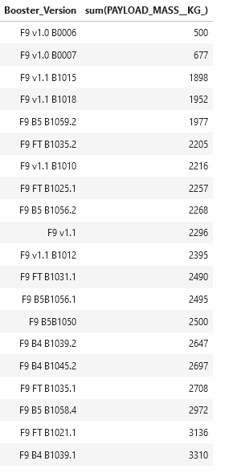
Total Payload Mass
Query
%sql SELECT Booster_Version, sum(PAYLOAD_MASS__KG_)
FROM SPACEXTABLE
WHERE Customer = "NASA (CRS)"
GROUP BY Booster_Version
ORDER BY 2
Explanation
Groups data by Booster_Version and sums Payload column based on its Booster_Version
Filters to NASA customers only
Orders by the summed column

Slide 27
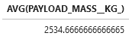
Average Payload Mass by F9 v1.1
Query
%sql SELECT AVG(PAYLOAD_MASS__KG_)
FROM SPACEXTABLE
WHERE Booster_Version LIKE "F9 v1.1%"
Explanation
Selects the average of the Payload from the table
Only averages data with Booster_Version F9 v1.1
Result

Slide 28
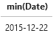
First Successful Ground Landing Date
Query
%sql SELECT min(Date)
FROM SPACEXTABLE
WHERE Landing_Outcome LIKE "%ground pad%"
Explanation
Selects the earliest date from the table
Filters data to Landing_Outcome having “ground pad” in the data
Result

Slide 29
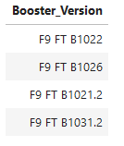
Successful Drone Ship Landing with Payload between 4000 and 6000
Query
%sql SELECT Booster_Version
FROM SPACEXTABLE
WHERE (PAYLOAD_MASS__KG_ > 4000 and PAYLOAD_MASS__KG_ < 6000)
and Landing_Outcome LIKE '%drone ship%’
and Landing_Outcome LIKE 'Success%'
Explanation
Returns Booster_Version from the table
Filters for Payload between 4,000kg and 6,000kg
Filters Landing Outcome to a success and drone ship
Result

Slide 30
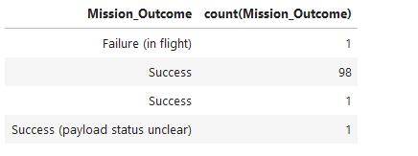
Total Number of Successful and Failure Mission Outcomes
Query
%sql SELECT Mission_Outcome, count(Mission_Outcome)
FROM SPACEXTABLE
GROUP BY Mission_Outcome
Explanation
Groups by possible mission outcomes
Selects number of mission outcome events
Result

Slide 31
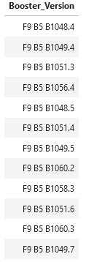
Boosters Carried Maximum Payload
Query
%sql SELECT distinct Booster_Version
FROM SPACEXTABLE
WHERE PAYLOAD_MASS__KG_ in (
SELECT MAX(PAYLOAD_MASS__KG_)
FROM SPACEXTABLE)
Explanation
Selects Booster_Version without any repeats from table
Uses sub-query to get highest maximum payload
Filters to only select boosters that have pulled maximum payload
Result

Slide 32
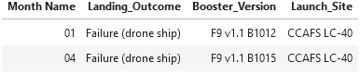
2015 Launch Records
Query
%sql SELECT substr(Date,6,2) AS 'Month Name', Landing_Outcome, Booster_Version, Launch_Site
FROM SPACEXTABLE
WHERE Landing_Outcome = 'Failure (drone ship)' AND substr(Date,0,5)='2015'
Explanation
Filters to failed drone ship landing outcomes that occurred in 2015
Selects month it occurred, landing outcome, booster, and launch site
Result

Slide 33
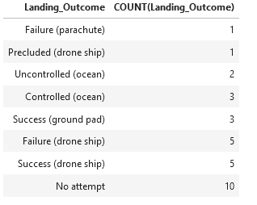
Rank Landing Outcomes Between 2010-06-04 and 2017-03-20
Query
%sql SELECT Landing_Outcome, COUNT(Landing_Outcome)
FROM SPACEXTABLE
WHERE (Date > '2010-06-04' and Date < '2017-03-20’)
GROUP BY 1
ORDER BY 2
Explanation
Filters table to fall in between 6/4/2010 – 3/20/2017
Ranks landing_outcome from lowest to highest
Groups by landing_outcome
Result

Slide 34

Section 3

Slide 35
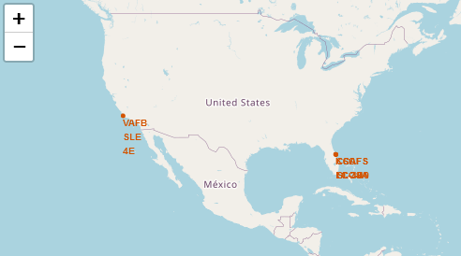
Launch Site Locations
Map shows Launch Site locations
Launch sites are all coastal
Florida contains multiple launch sites

Slide 36
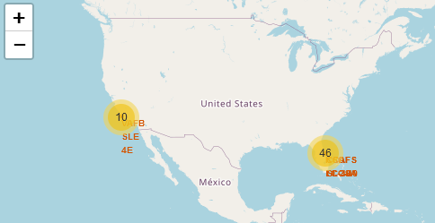
Volume of Launches by Location
Most launches take place in Florida

Slide 37
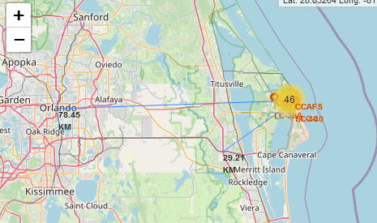
Space Station Proximity
78.5KM from Orlando
29.2KM from freeway
On the coast
Water landings
Prevent civilian injuries

Slide 38

Section 4

Slide 39
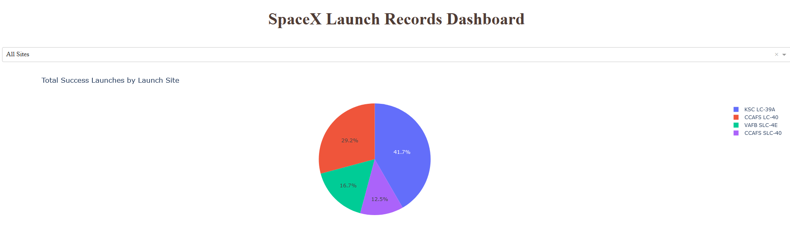
Successful Launches by Launch Site
Total Successful Launches by Launch Site
Of the successful launches, 41.7% launch from Kennedy Space Center

Slide 40
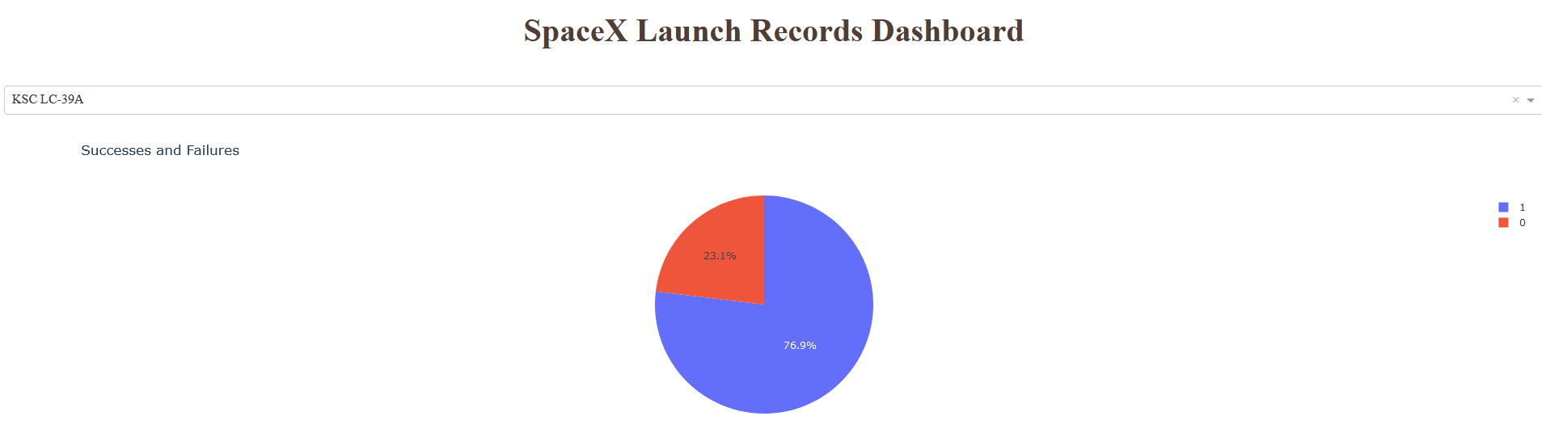
Kennedy Space Center Launch Success
The success and failure rate of all launches at Kennedy Space Center
76.9% of launches from Kennedy Space Center succeed

Slide 41
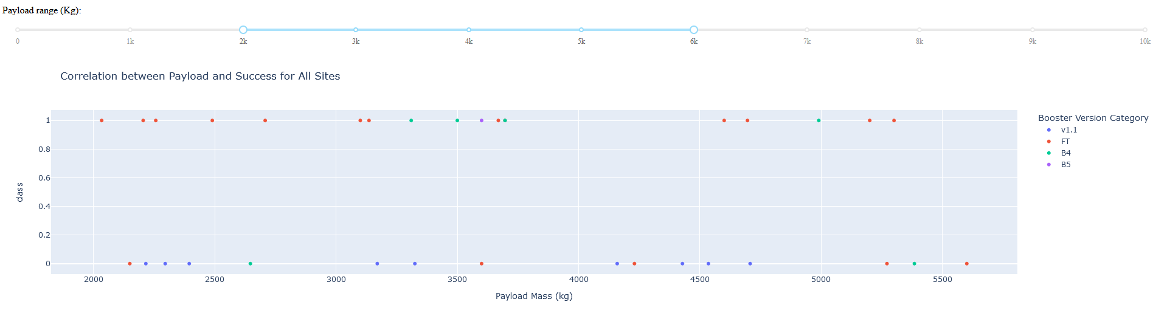
Correlation between Payload and Success for All Sites
Provides success and failure values for all sites between a payload range
Provides which booster categories were attached to each launch
The FT Booster Category seems to have a high success rate
The graph can also filter by launch site

Slide 42

Section 5

Slide 43
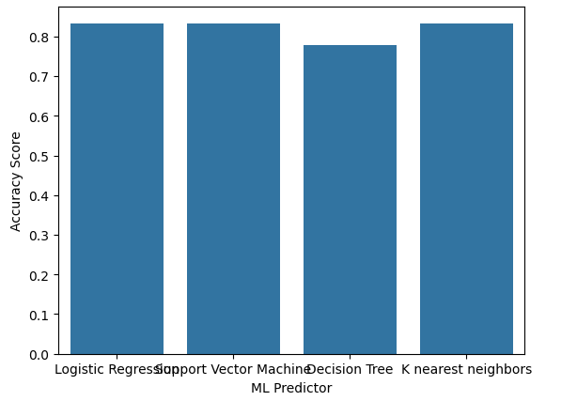
Classification Accuracy
Accuracy Scores are similar across all four models
Models have been optimized by passing various parameters to produce best model
No test stands out as the best meaning any classification system can be used
Decision Tree accuracy fluctuates slightly and therefore should be eliminated

Slide 44
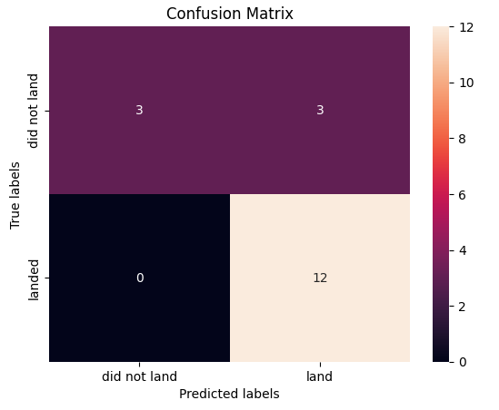
Confusion Matrix
The Confusion Matrix is similar across remaining three models
Models all correctly predict “Land” but do have some False Positives
This 83% Accuracy can be useful in deciding whether future launches are viable

Slide 45
Conclusions
Payload, Orbit Type, and Launch Site play a huge role in determining mission success and Landing Outcome
It is possible that Booster Version could play a greater role, but needs to be analyzed further
Launch Sites are required to be on the coast with some distance from cities
Several classification Machine Learning methods can be used to determine success and failure of missions, but are not 100% accurate

Slide 46


Slide 47
Appendix A: GitHub Notebook Links
Collecting Data: https://github.com/bleepbloop1213/AppliedDataScienceCapstone/blob/main/jupyter-labs-spacex-data-collection-api.ipynb
Webscraping: https://github.com/bleepbloop1213/AppliedDataScienceCapstone/blob/main/jupyter-labs-webscraping.ipynb
Data Wrangling: https://github.com/bleepbloop1213/AppliedDataScienceCapstone/blob/main/labs-jupyter-spacex-Data%20wrangling.ipynb
Exploratory Data Analysis (SQL): https://github.com/bleepbloop1213/AppliedDataScienceCapstone/blob/main/jupyter-labs-eda-sql-coursera_sqllite.ipynb
Exploratory Data Analysis (Visualization): https://github.com/bleepbloop1213/AppliedDataScienceCapstone/blob/main/jupyter-labs-eda-dataviz.ipynb.jupyterlite.ipynb
Folium: https://github.com/bleepbloop1213/AppliedDataScienceCapstone/blob/main/lab_jupyter_launch_site_location.jupyterlite.ipynb
Dashly Dashboard: https://github.com/bleepbloop1213/AppliedDataScienceCapstone/blob/main/spacex_dash_app.py
ML Predictions: https://github.com/bleepbloop1213/AppliedDataScienceCapstone/blob/main/SpaceX_Machine_Learning_Prediction_Part_5.jupyterlite.ipynb

